Slide 1

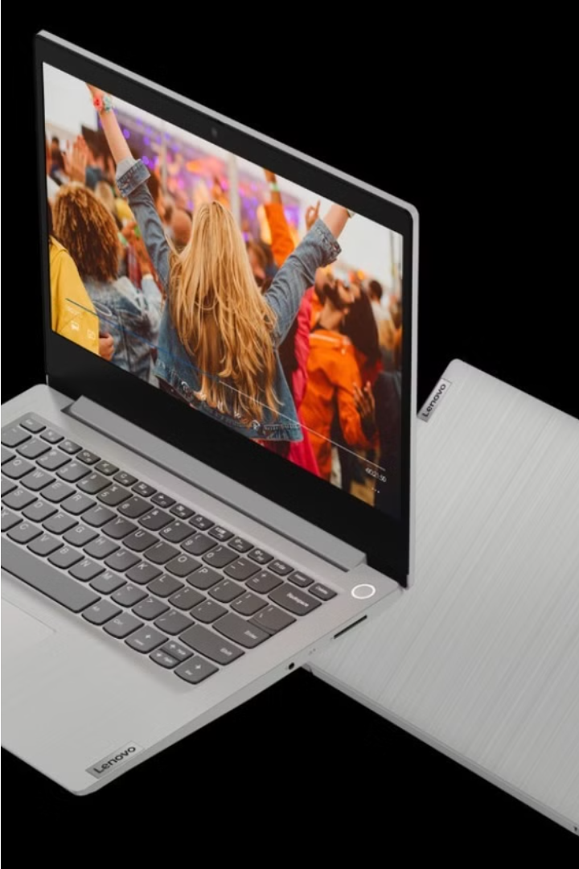

Clone of Lenovo India Website
In our project, we set out on cloning the official Lenovo India website, aiming to replicate its design, functionality, and user experience. This presentation will guide you through our development journey, the challenges encountered, and the innovative solutions devised.

Slide 2
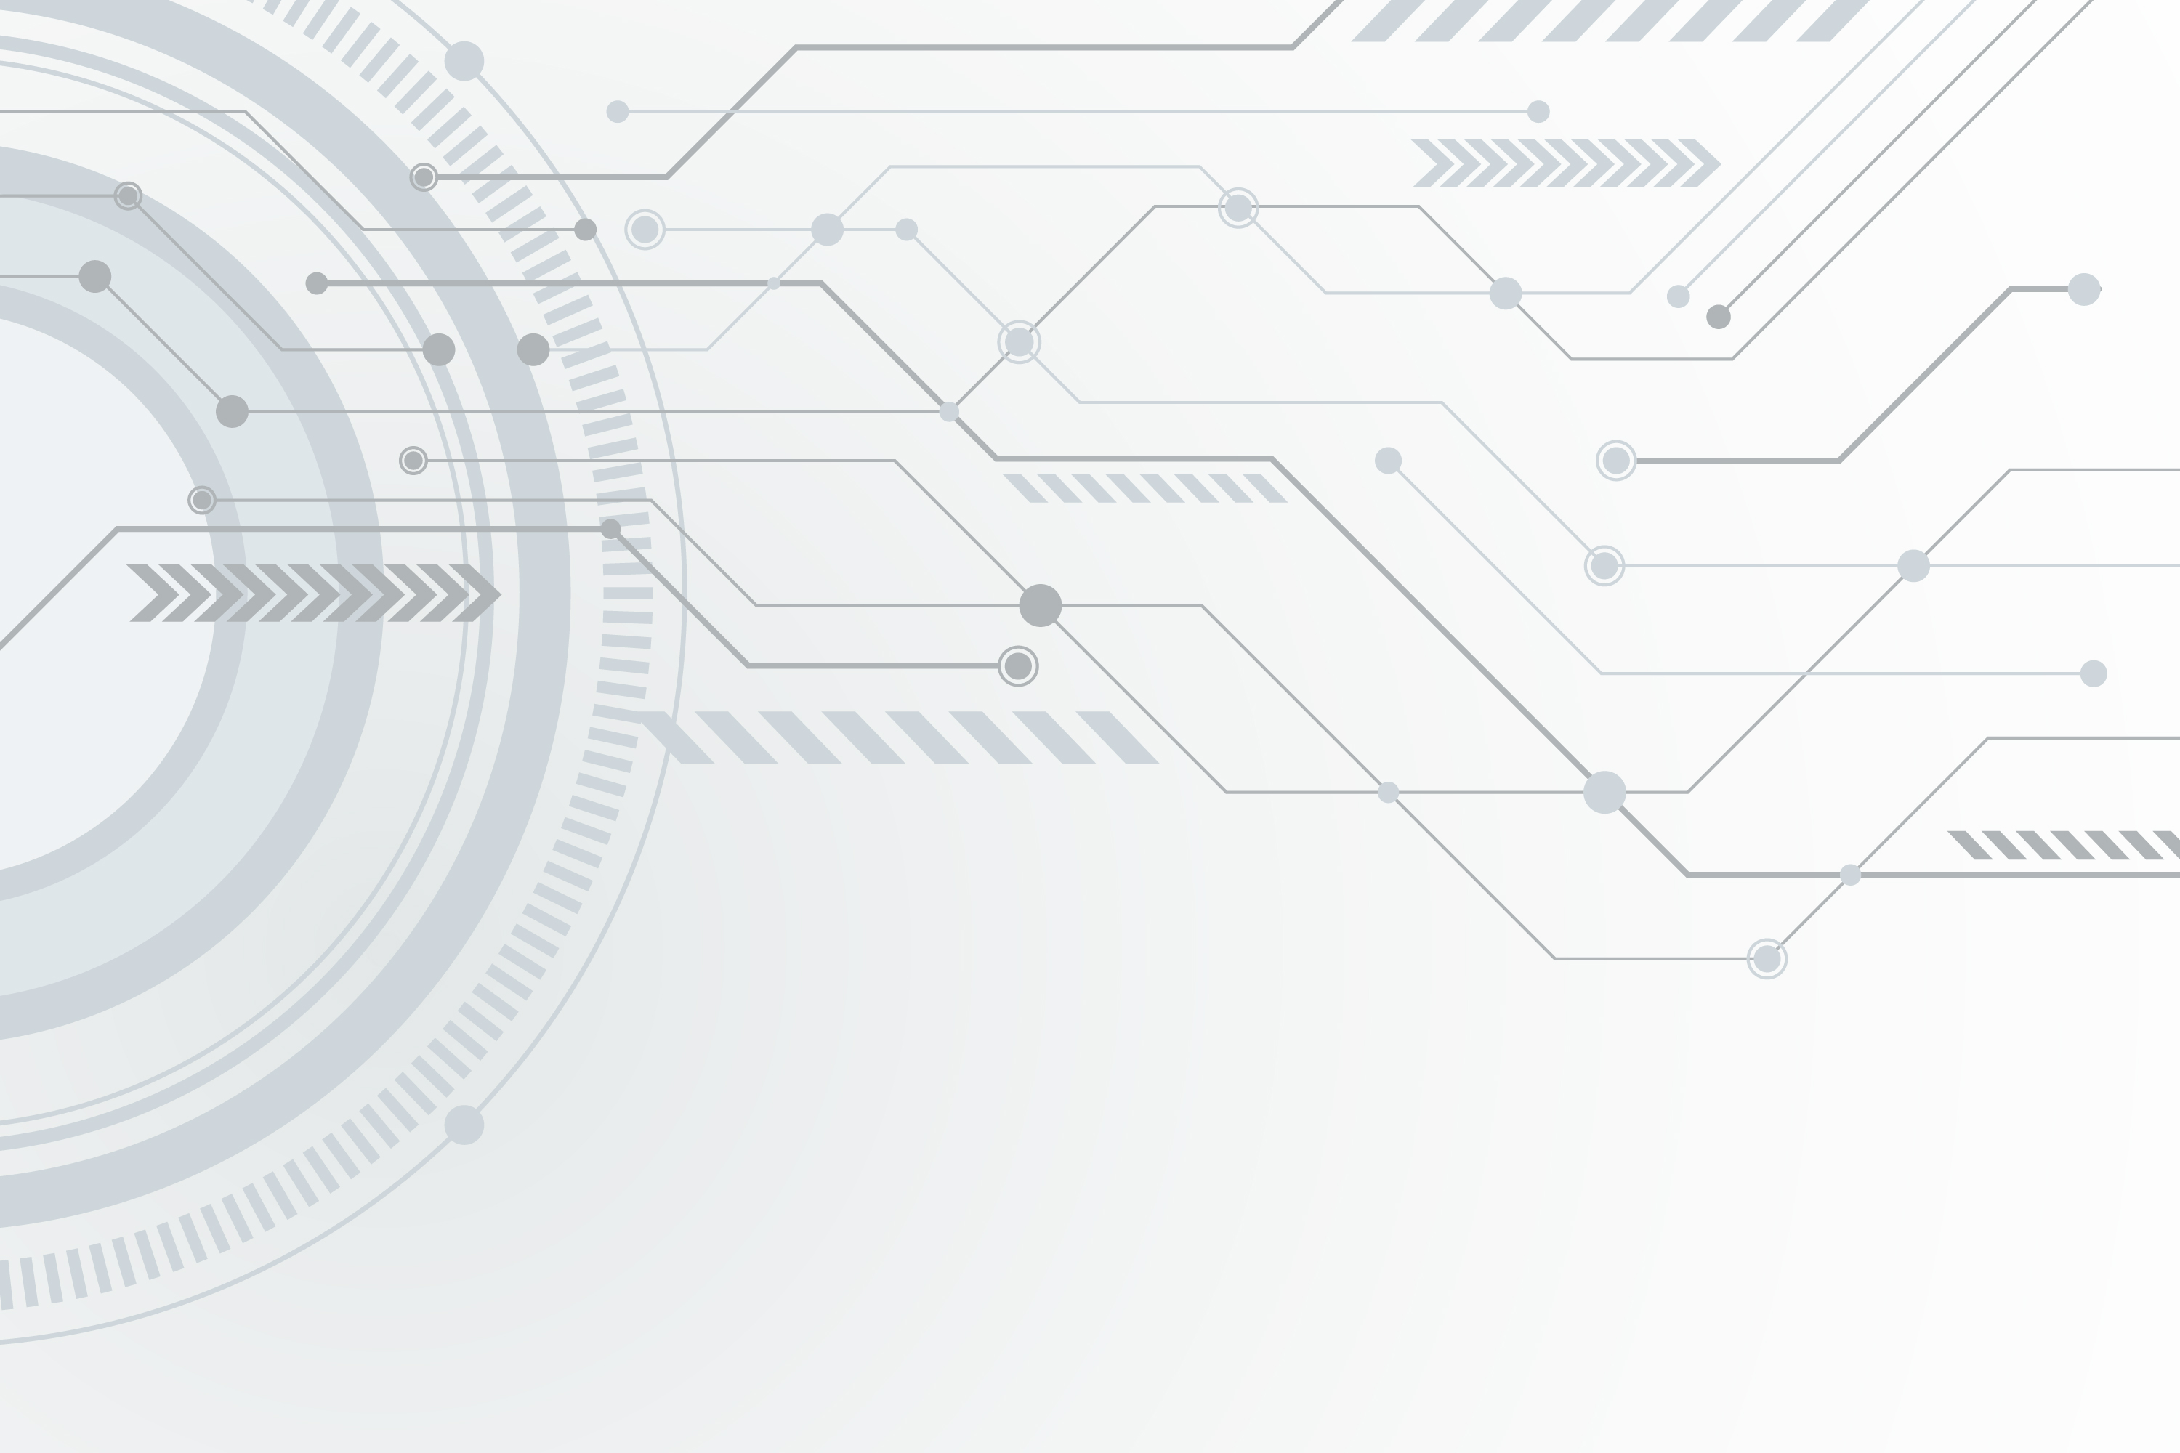

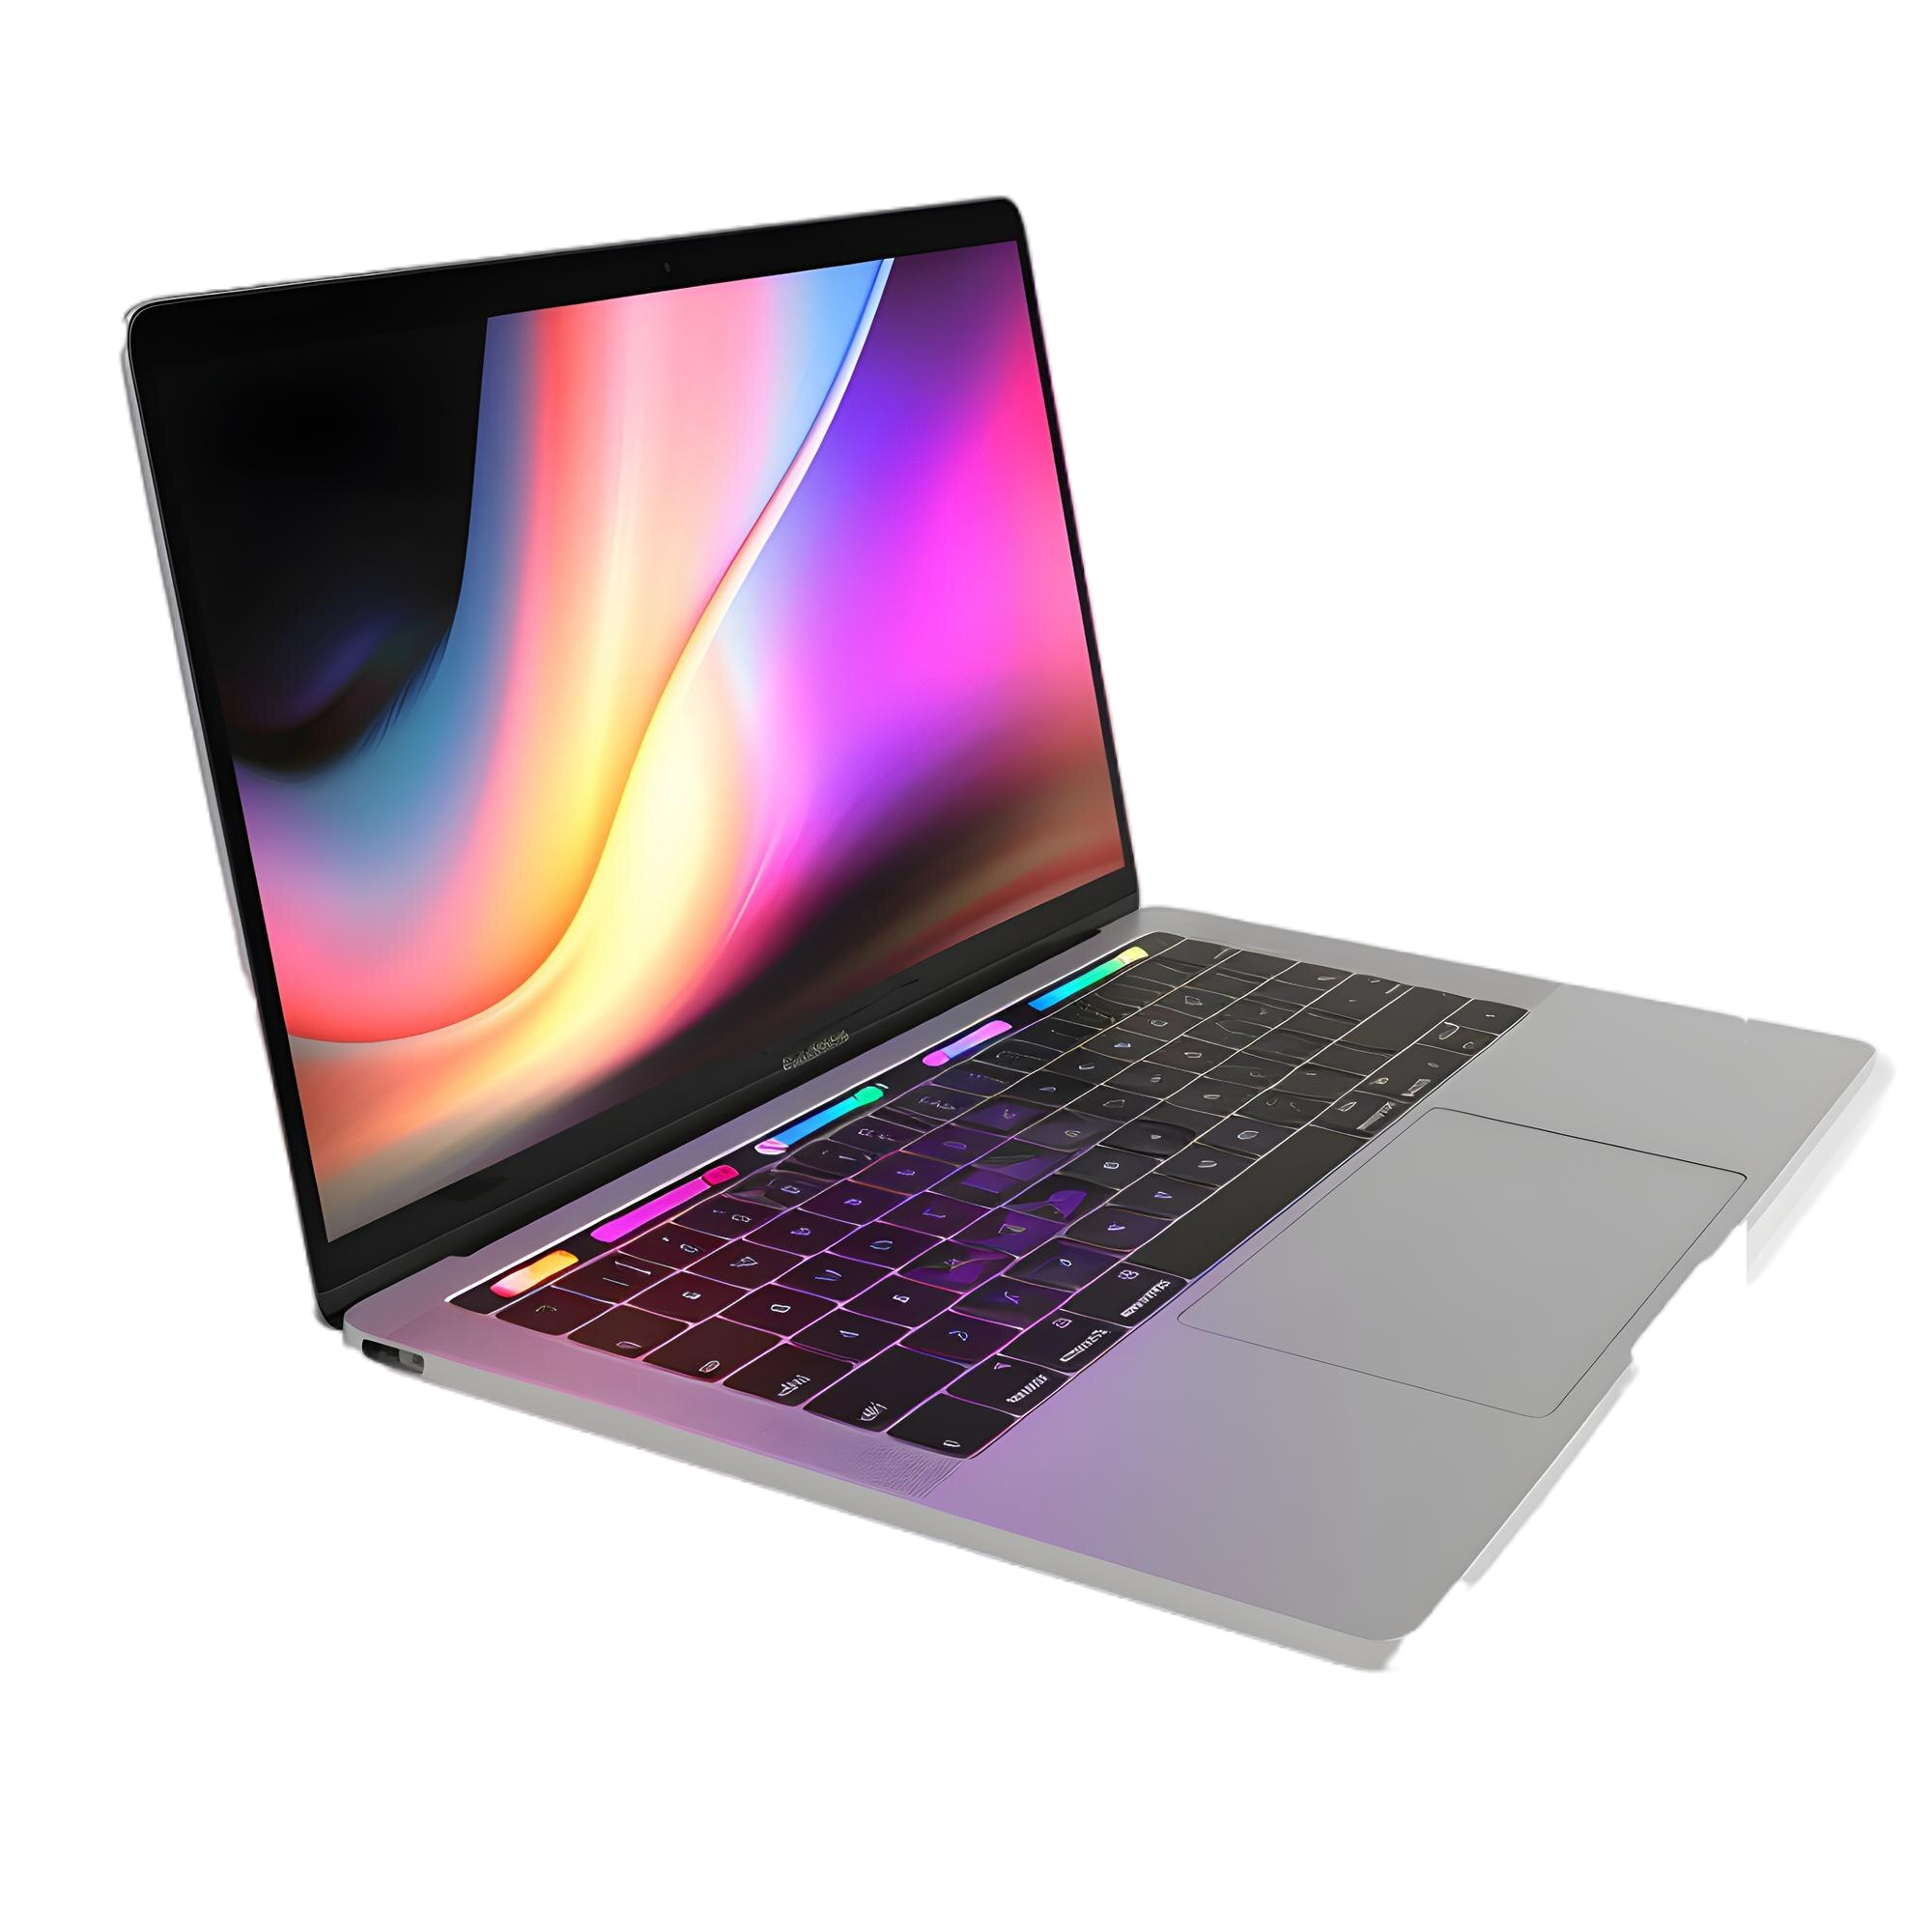
Started by a group of Chinese researchers, Lenovo acquired IBM's Personal Computer Division in 2005, which significantly boosted their PC market share.
A Chinese multinational technology company founded in 1984.
Specializes in designing, manufacturing, and marketing consumer electronics, PCs, software, and related services
They are known for the World's Largest PC Manufacturer: Lenovo holds the top spot for global PC sales.. And have Global Presence: Operates in over 180 markets with a workforce of around 75,000 employees.

Slide 3

Challenges Faced During Cloning
Making Responsive design
1
Duplicating The
UI
2
Recreating the complex UI and interactive element of the Lenovo India was a significant challenge for us
Ensuring the website's responsiveness and seamless user experience across different devices and screen sizes was crucial.
But we’ve fixed it with the media query in css

Slide 4
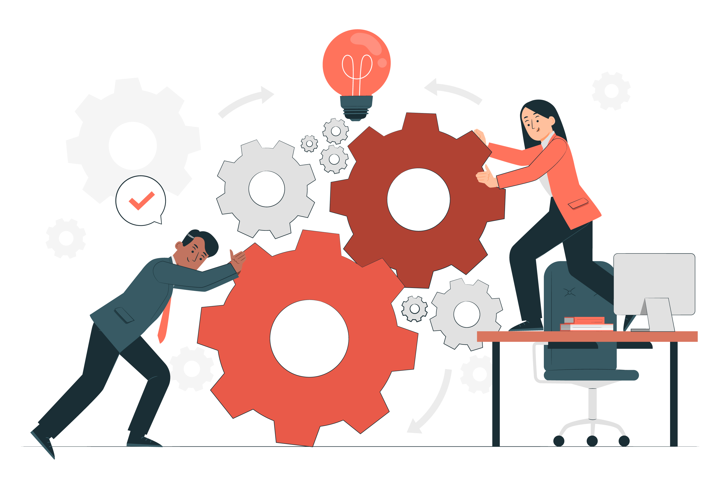
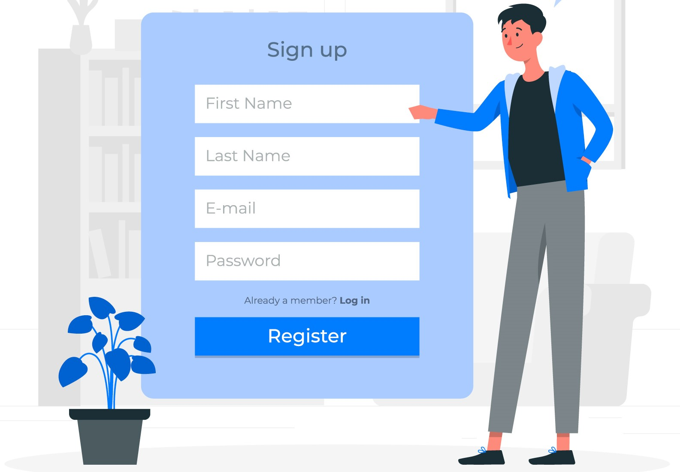
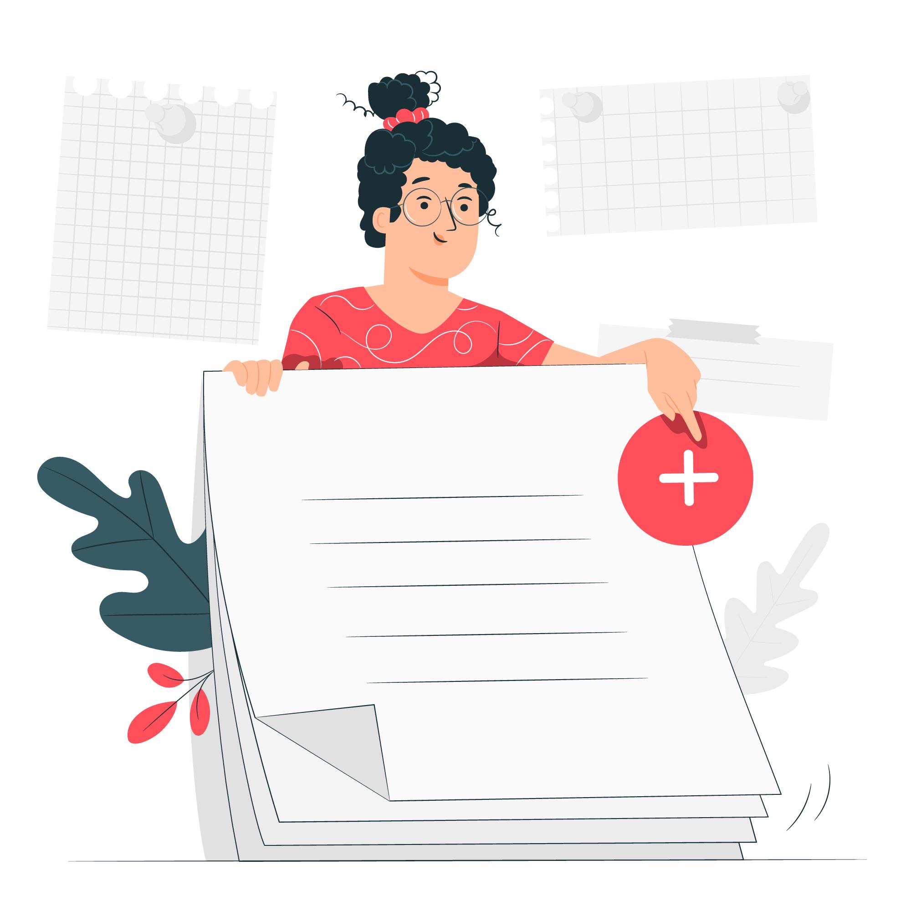
Functionality
Sign In/Out
Users can securely sign in and out of their accounts, accessing personalized features. .
Wish list
In order of implementing the fuction we have also implement a fuction of adding item in wishlist in our project with the help of wish list user can save his/her item in the wish list if they are considering to purchasing it later and they can track the price of the product

Slide 5
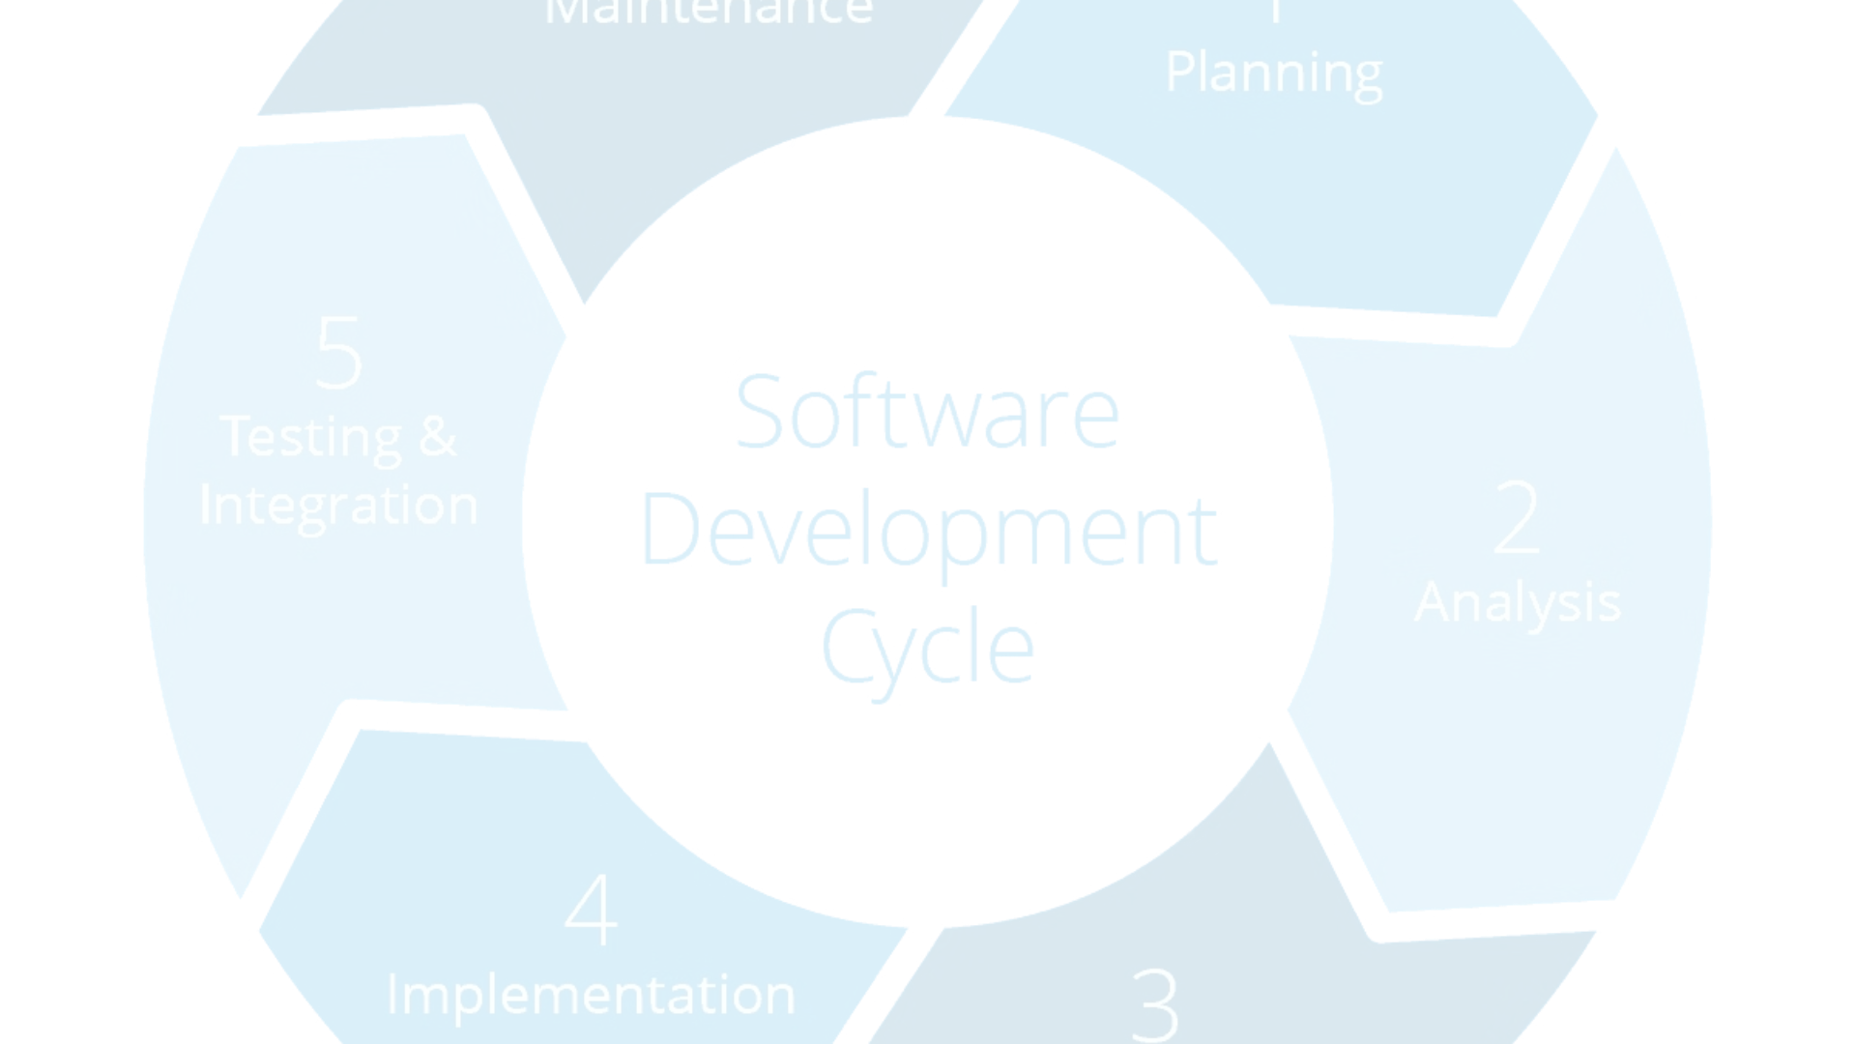

Development Methodology
Planning
Implementation
We began with a comprehensive planning phase, defining project scope, user requirements, and development milestones.
We followed an Flexible development approach to build and test the website's functionality.
1
2
3
Design
We’ve worked with our team to make this website more user flexible and responsive design, ensuring it aligned with the original Lenovo India website's branding and user experience.

Slide 6
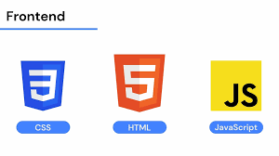
Technology Stack used
</>
{:}
( );
{B}
HTML
CSS
JavaScript
Bootstrap
The foundation of our website, used for structuring the content and layout.
We’ve used Css for the better styling and the responsiveness and in css we’ve used the media query and css grid , css flex etc.
Bootstrap is a free, open source front-end development framework for the creation of websites and web apps. Designed to enable responsive development of mobile-first websites, Bootstrap provides a collection of syntax for template designs.
Utilized for adding interactivity, dynamic features and some functionality .

Slide 7




Design Decisions
User-Centric
Alignment
Responsive Layouts
Our design decisions were developed by the understanding of the deep driven understanding of user needs.
We aligned this clone website visual design and branding with Lenovo's established identity, maintaining consistency and similarity with the original website.
We prioritized responsive design, optimizing the website for various devices and screen sizes to relate with the user screen preference

Slide 8

Conclusion and Future Work
In conclusion, the cloning of the Lenovo India website will be educational experience for our team we are happy that we’ve solved the problem that we are facing and that we’ve faced and also the level of detail we achieved to make replica of this website as well as our team is working on cloning of this website day by day and exploring the feature of this website to make it more user friendly and personalized user experience

Slide 9
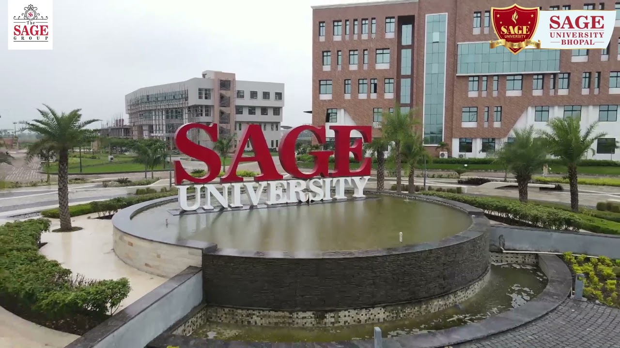
THANK YOU

